Slide 1
Project Based learning Group-3 Project-24
2000080005
Praveen kumar

Slide 2
Aim of the Project:-
Predicting Wine Quality using machine learning model .
Dataset Link: https://archive.ics.uci.edu/ml/datasets/wine+quality

Slide 3
Overview:-
Data description
Importing libraries
Reading dataset
Visualization
Handle null values
Split dataset
Normalization
Applying model
Accuracy

Slide 4
Data Description:-
Data can be used to classify the quality of wine and we can use many of chemicals in that wine , So we need to have a basic understanding of such chemicals.
Volatile acidity
Fixed acidity
Residual sugar
Citric acid
Free sulfur dioxide
total sulfur dioxide
pH
Density sulphates
alcohol

Slide 5
Importing Libraries:-
Import pandas as pd
Import numpy as np
Import seaborn as sns
Import matplotlib.pyplot as plt
from sklearn.model_selection import train_test_split
from sklearn.preprocessing import MinMaxScaler
from sklearn.ensemble import RandomForestClassifier
from sklearn.metrics import classification_report

Slide 6
Reading dataset:-
df = pd.read_csv(‘winequality.csv’)
df
df.head()
df.info()
df.describe()
df.tail()
df.dtypes

Slide 7
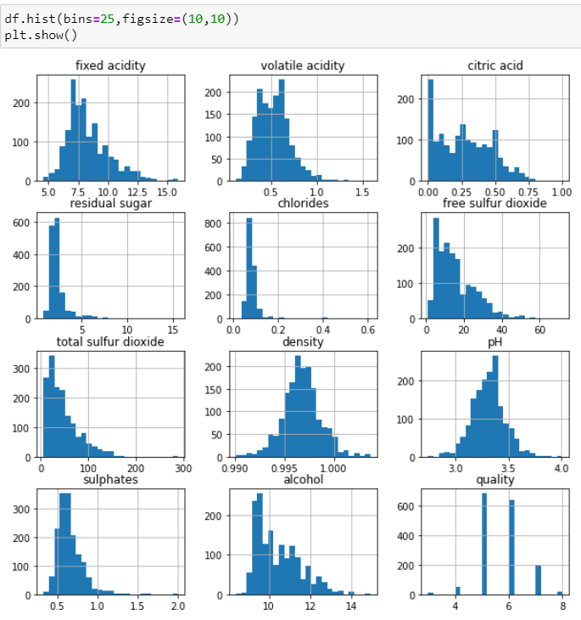
Visualization:-
It shows like a image which is used to find all useful information.
And it shows a graphic representation.
In these visualization ‘image speaks everything’.
it shows like this →

Slide 8
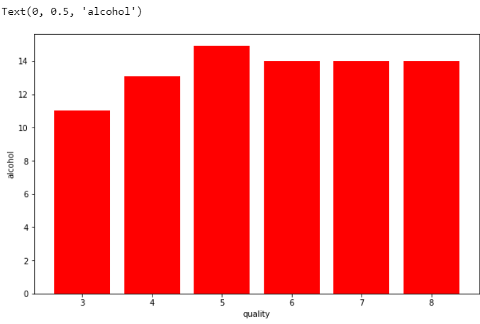
Now, we plot the bar graph in which we check what value of alcohol can able to make changes in quality
plt.figure(figsize=[10,6])
plt.bar(df['quality'],df['alcohol'],color='red')
plt.xlabel('quality')
plt.ylabel('alcohol')

Slide 9
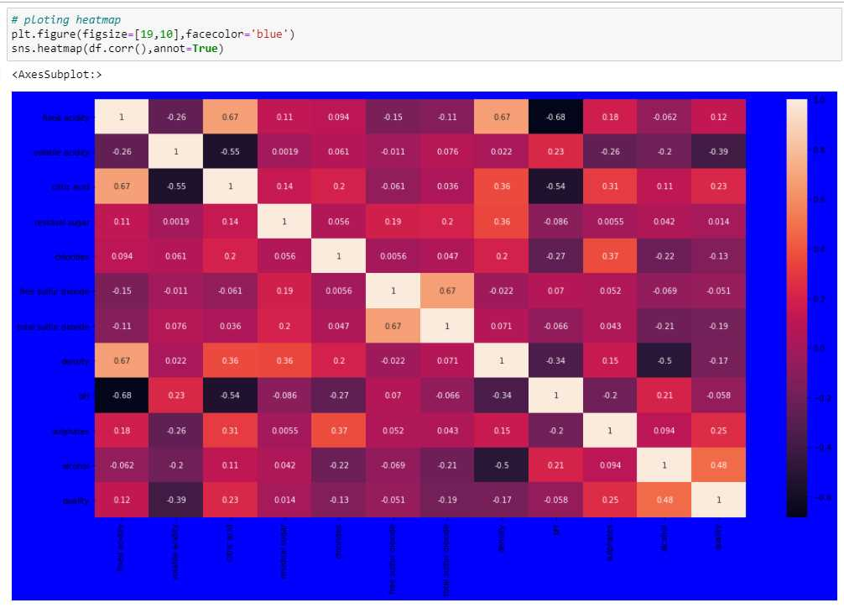
Correlation:-
Now , we will perform a correlation on the data to see how many features are there they correlated to each other
For checking correlation we use a statistical method that finds the bonding and relationship between two features.

Slide 10
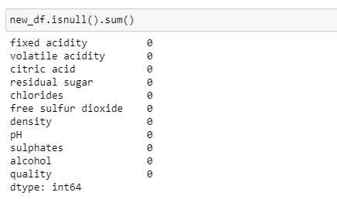
Handle null values:-
In machine learning, there are many ways to handle null or missing values .
Now , we will use them to handle our unorganized data.
.new_df.isnull().sum()

Slide 11
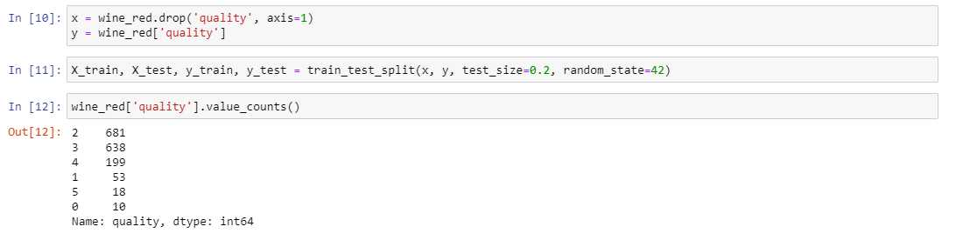
Splitting dataset:-
Now we perform a split operation on our dataset
from sklearn.model_selection import train_test_split
x_train,x_test,y_train,y_test = train_test_split(x,y,test_size=0.2,random_ state=40)

Slide 12
Normalization:-
We do normalization on numerical data because
our data is unbalanced it means that the
difference between the variable values is high
so we convert them into 1 and 0.

Slide 13
Applying Model:-
It was the last step.
When we are apply any
suitable model it will give more accuracy.
So , here we are applying Random Forest Classifer
because it was one of the ML model that gives
the 88% accuracy , which was considered as the best
accuracy .

Slide 14
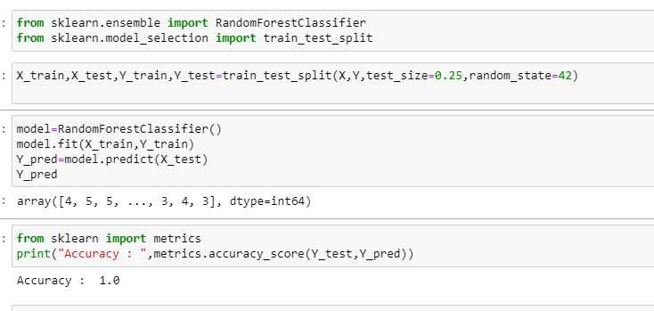
Accuracy:-
By using
Random Forest Classifier
I was got the Accuracy :
1.0 .
And next we can
differentiate the predicted
values and actual values.

Slide 15
Thank you 🙂.

